Slide 1

Driverless Car-Part I
Presented By : The Assembly Team

Slide 2
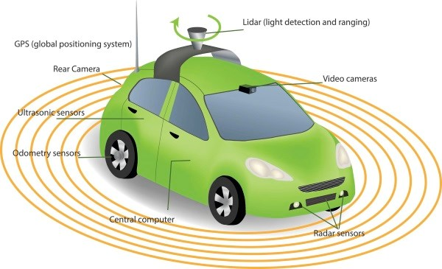
Introduction
What is a driverless car?
A driverless car is an unmanned vehicle which uses data from surroundings to sense its environment to navigate around without any human input.

Slide 3
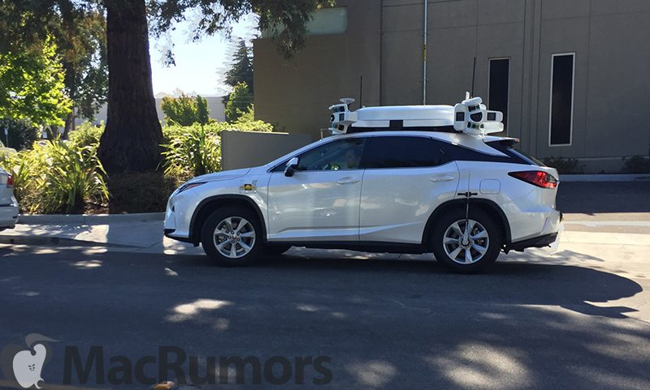
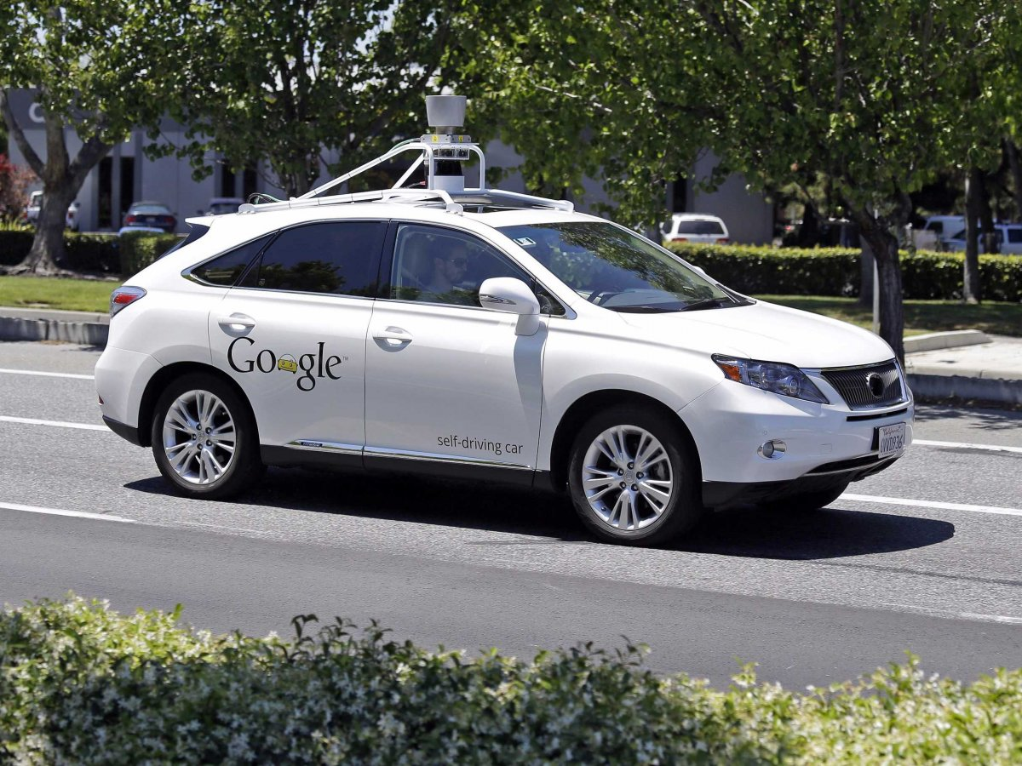
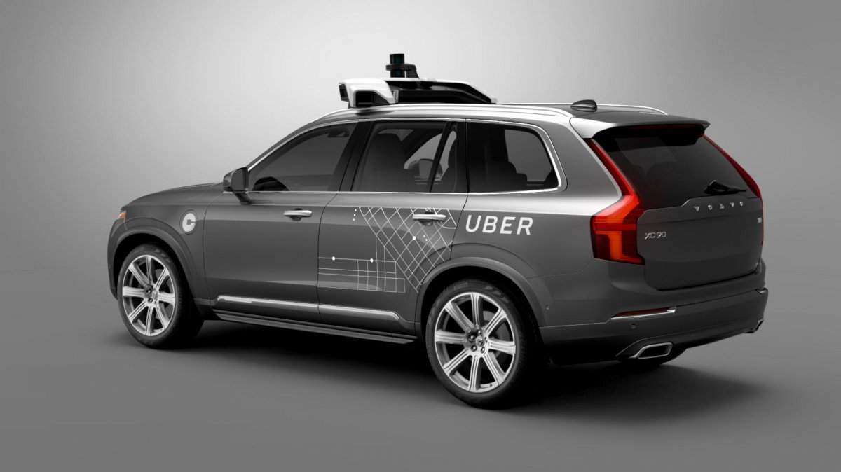

Slide 4
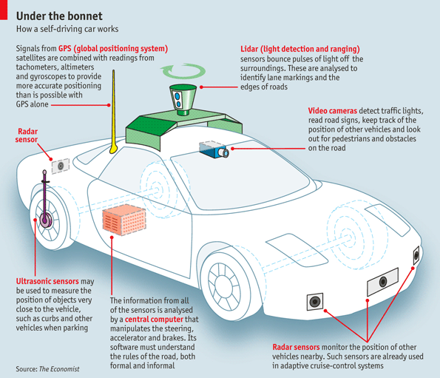

Slide 5
Driverless Car’s in Dubai

Slide 6
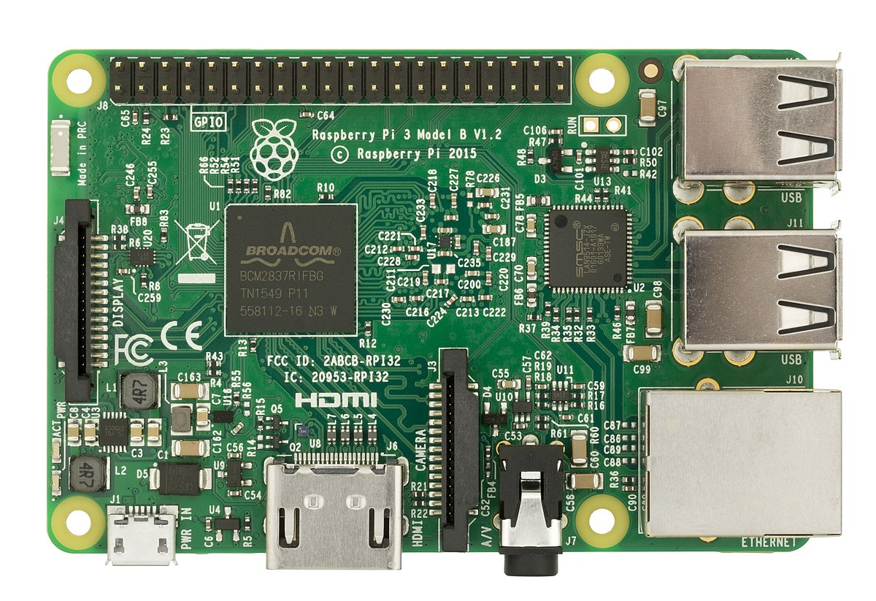
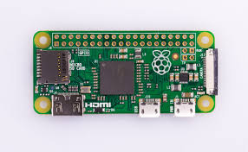
Raspberry Pi

Slide 7
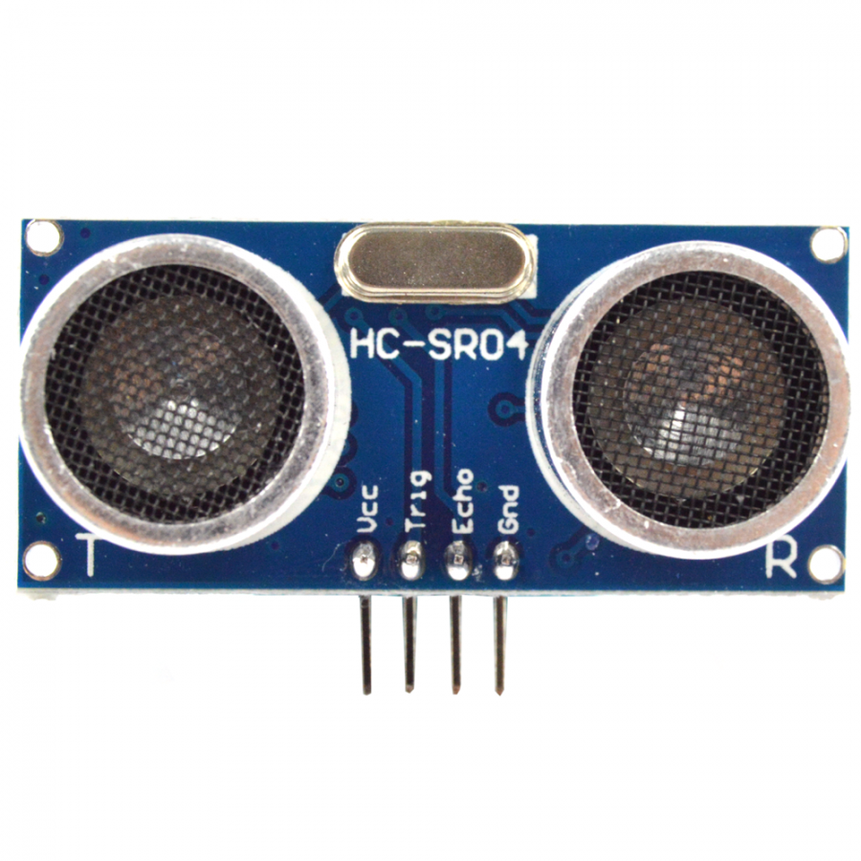
Ultrasonic sensor

Slide 8
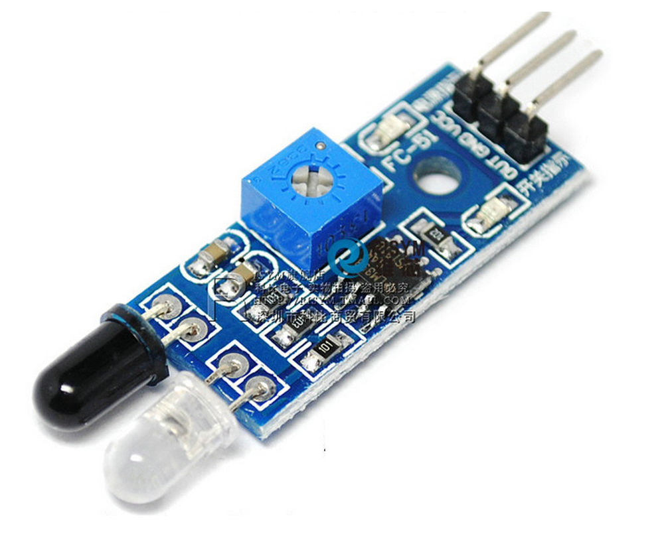
Infrared sensor

Slide 9
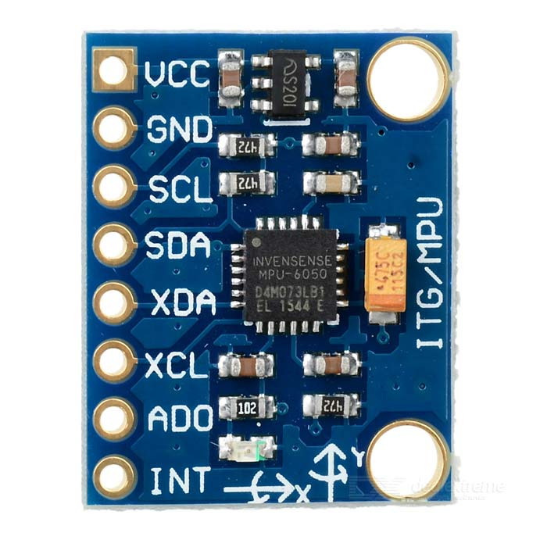
MPU-6050

Slide 10
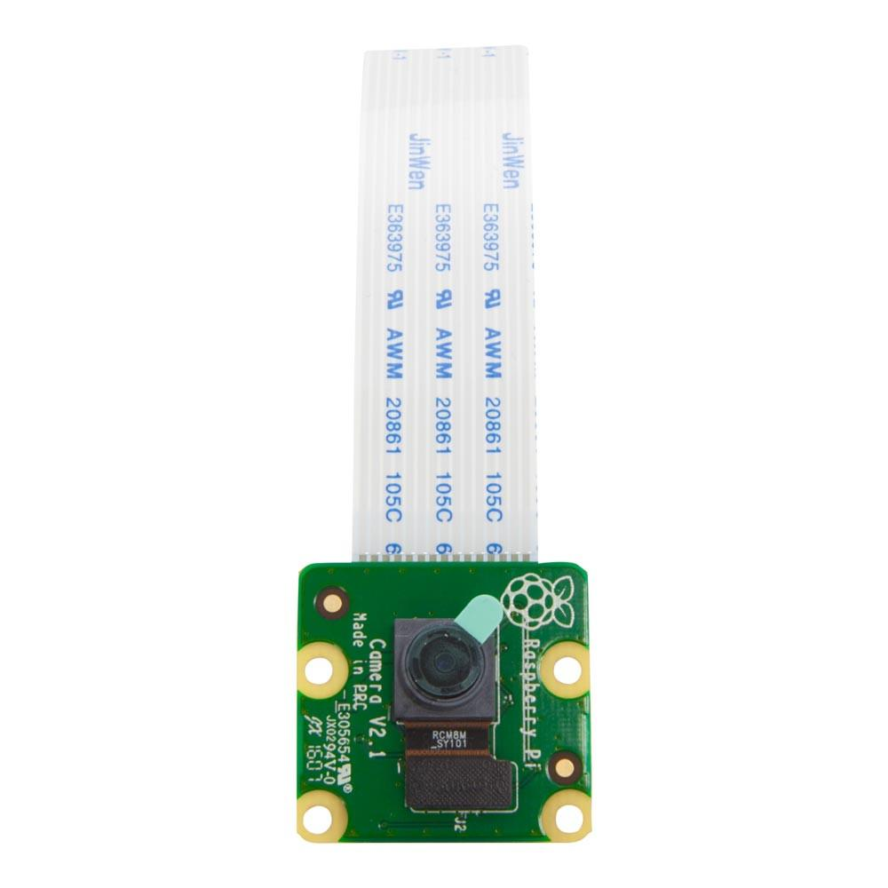
Pi camera

Slide 11
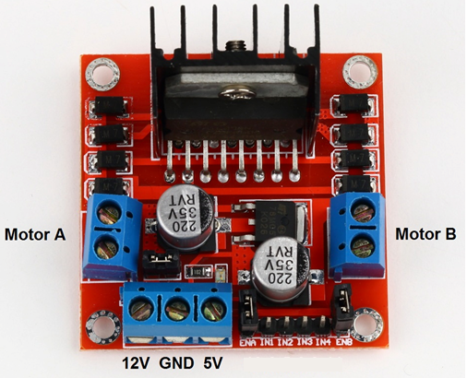
L298N Motor Driver
Notes:
Read more http://www.geeetech.com/wiki/index.php/L298N_Motor_Driver_Board
Tutorial http://www.instructables.com/id/Control-DC-and-stepper-motors-with-L298N-Dual-Motor/
*H-Bridges can also be used for other projects such as driving the brightness of certain lighting projects such as high powered LED arrays.
*Pulse Width Modulation is a means in controlling the duration of an electronic pulse
*Motors are rated at certain voltages and can be damaged if the voltage is applied to heavily or if it is dropped quickly to slow the motor down.
The longer the pulses the faster the wheel will turn, the shorter the pulses, the slower the water wheel will turn.

Slide 12
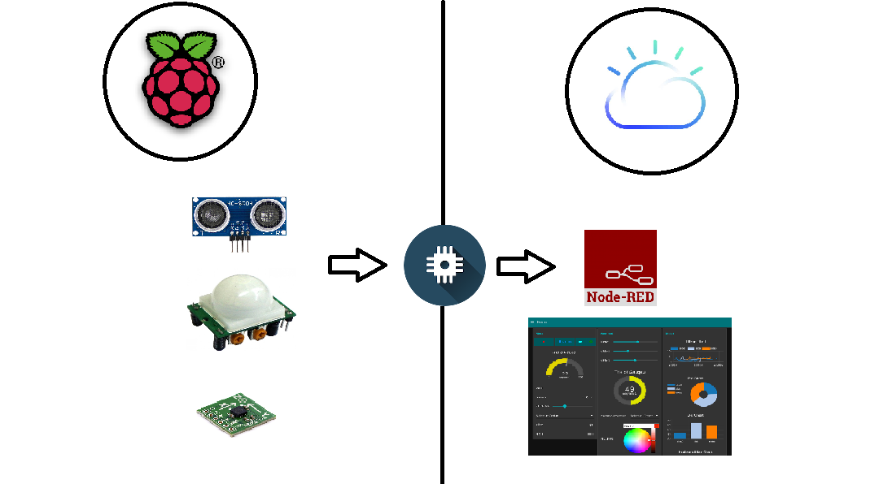
Architecture Diagram
Notes:
Read more http://www.geeetech.com/wiki/index.php/L298N_Motor_Driver_Board
Tutorial http://www.instructables.com/id/Control-DC-and-stepper-motors-with-L298N-Dual-Motor/
*H-Bridges can also be used for other projects such as driving the brightness of certain lighting projects such as high powered LED arrays.
*Pulse Width Modulation is a means in controlling the duration of an electronic pulse
*Motors are rated at certain voltages and can be damaged if the voltage is applied to heavily or if it is dropped quickly to slow the motor down.
The longer the pulses the faster the wheel will turn, the shorter the pulses, the slower the water wheel will turn.

Slide 13
Todays workshop
Car to be moved around using a mobile phone connected to the raspberry pi by Bluetooth.
As the car moves, sensor data (infrared, ultrasonic and accelerometer readings) will be sent to the IBM cloud for further processing

Slide 14
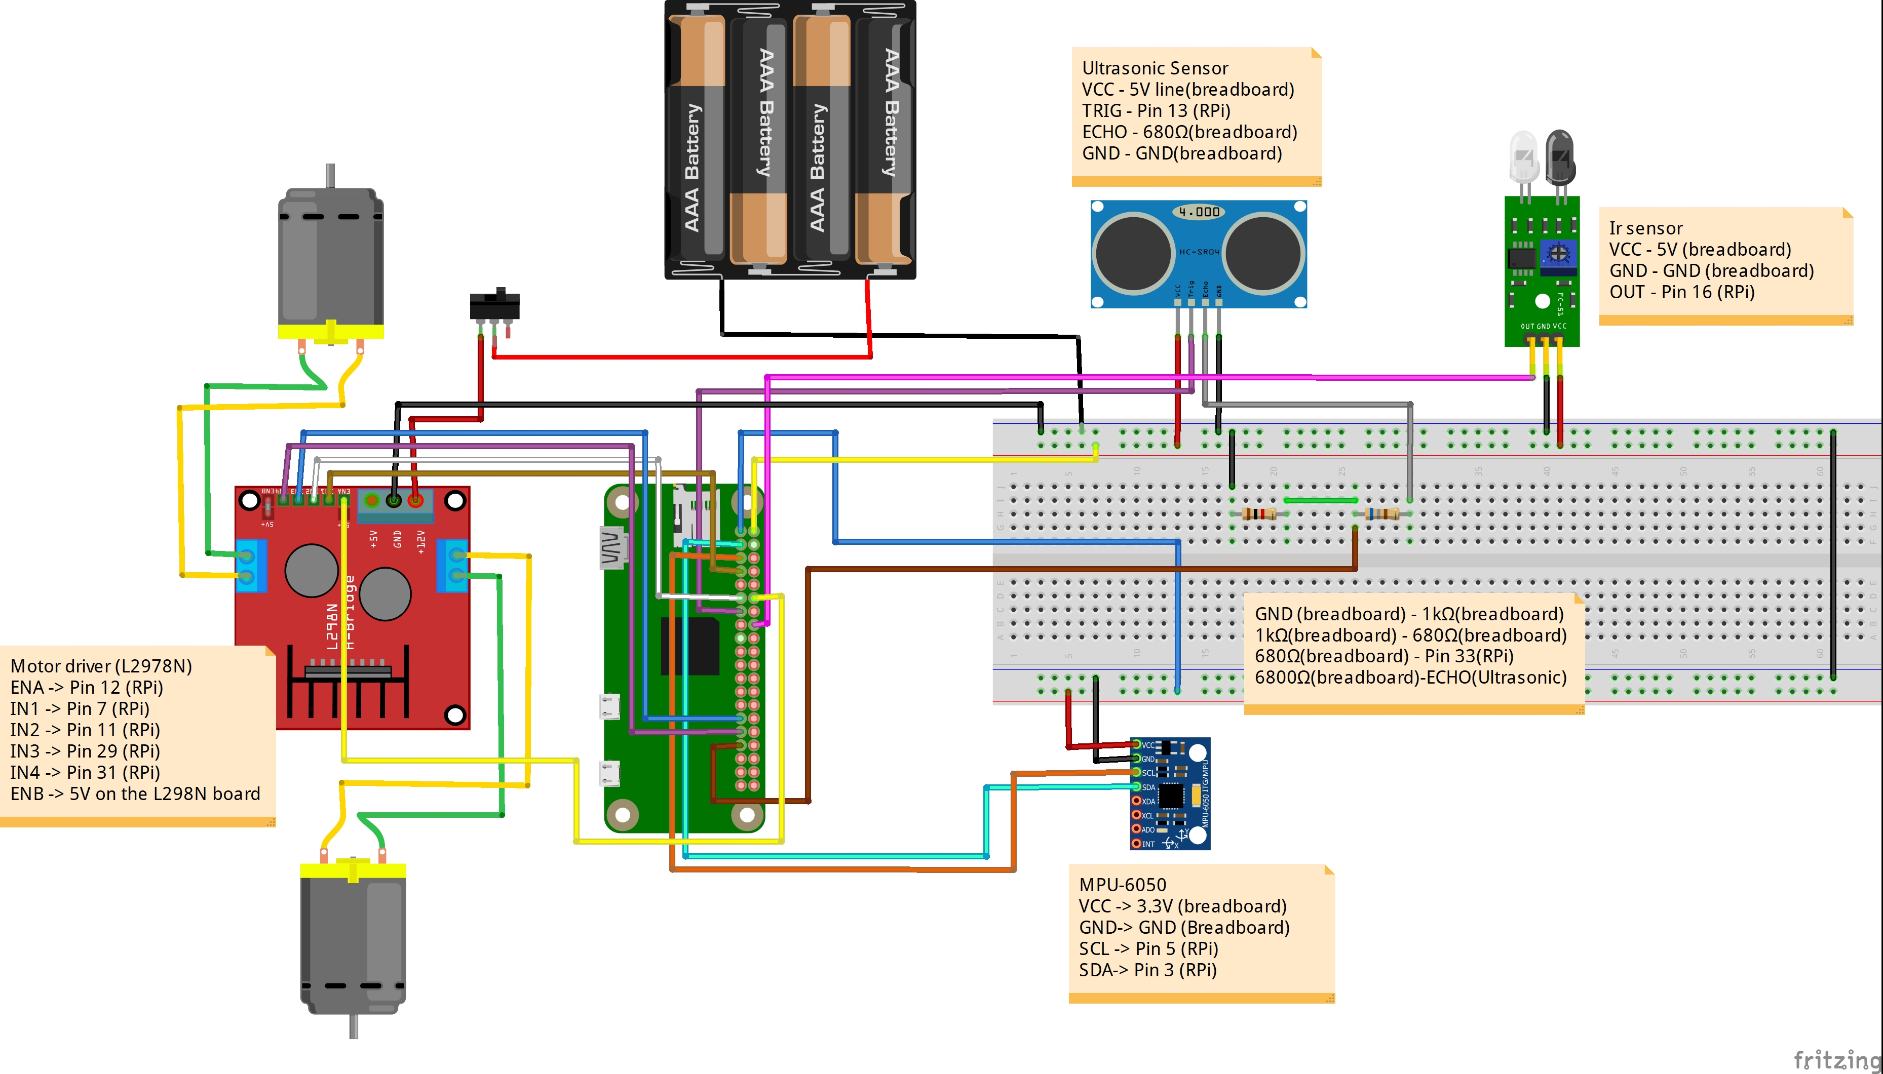
The Circuit Diagram

Slide 15
Software
Register to IBM cloud
http://ibm.biz/AssemblyCar1
To get the instructions and other files go to:
https://github.com/Kuroi-Yuki/Driver-Behaviour-Node-RED
https://github.com/The-Assembly/IBM_selfdriving
Download Blueterm on your phone

Slide 16
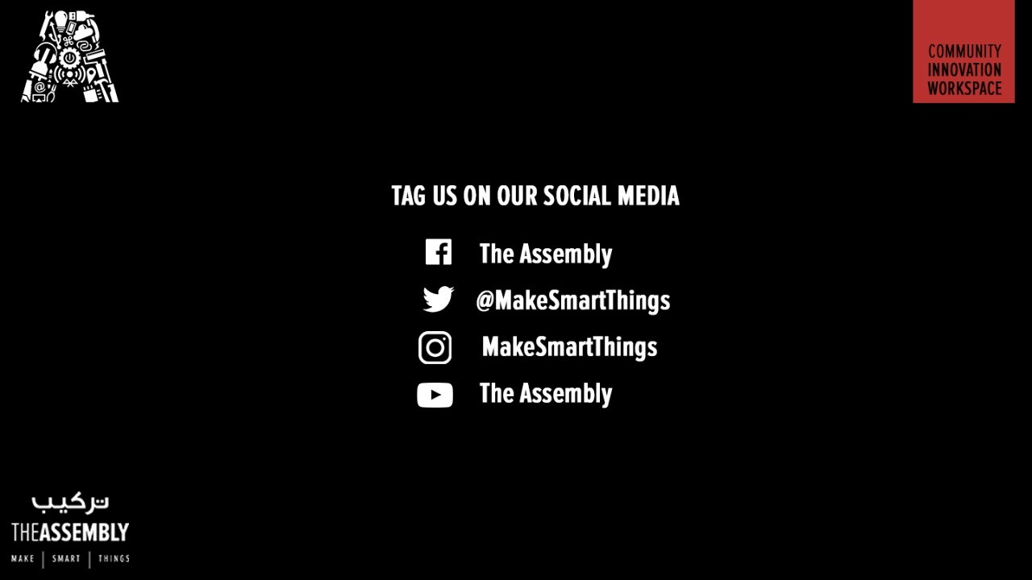
THANK YOU
THANK YOU

